Slide 1
100 Days of Scala
Greg Hazen

Slide 2
Outline
Scala 101
Who is Scala Right For?
Learning More

Slide 3
Outline
Why Scala?
“Scalable Language”
Compatible
Concise
Strong Type Inference
High Level
Static Type

Slide 4
Scala 101

Slide 5
Scala 101 - Hello World
object HelloWorld { def main(args: Array[String]): Unit = { println("Hello, World!") } }

Slide 6
Scala 101 - Hello World
object HelloWorld { def main(args: Array[String]): Unit = { println(getGreeting) } def getGreeting: String = "Hello, World!" }
import org.scalatest.FlatSpec class HelloWorldSpec extends FlatSpec { "getGreeting" should "return Hello, World" in { assert(HelloWorld.getGreeting == "Hello, World!") } }

Slide 7
Scala 101 - Variables
var mutableVariable: Int = 0 val immutableVariable: Int = 0 def incrementMutableVariable: Int = { mutableVariable = mutableVariable + 1 mutableVariable } // Won't compile // def incrementImmutableVariable = immutableVariable = immutableVariable + 1
var mutableVariable: Int = 0 val immutableVariable: Int = 0 def incrementMutableVariable: Int = { mutableVariable = mutableVariable + 1 mutableVariable } // Won't compile // def incrementImmutableVariable = immutableVariable = immutableVariable + 1
assert(incrementMutableVariable == 1) assert(incrementMutableVariable == 2) assert(incrementMutableVariable == 3) assert(incrementMutableVariable == 4)
“…val and var are just two different tools in your toolbox…”

Slide 8
Scala 101 - Functions
def add(a: Int, b: Int): Int = a + b
def add(a: Int, b: Int): Int = a + b
// Note Scala is purely object-oriented def addIsActuallyAFunction(a: Int, b: Int): Int = a.+(b)
// Note Scala is purely object-oriented def addIsActuallyAFunction(a: Int, b: Int): Int = a.+(b)
assert(add(1, 2) == 3)
assert(add(1, 2) == addIsActuallyAFunction(1, 2))

Slide 9
Scala 101 - Functions
def placeholders = (_: Int) + (_: Int)
def placeholders = (_: Int) + (_: Int) def placeholdersWithParams = (a: Int, b: Int) => a + b
assert(placeholders(1, 2) == 3)
assert(placeholders(1, 2) == 3) assert(placeholdersWithParams(1, 2) == 3)
How do you keep your team consistent?

Slide 10
Scala 101 - Classes
class MyClass(val a: Int, b: String) { val c: Int = 3 }
val classInstance = new MyClass(1, “b")
assert(classInstance.a == 1) // Doesn't compile // assert(classInstance.b == "b") assert(classInstance.c == 3)

Slide 11
Scala 101 - Classes
case class MyCaseClass(a: Int, b: String) { val c: Int = 3 }
val caseClassInstance = new MyCaseClass(1, "b")
assert(caseClassInstance.a == 1) assert(caseClassInstance.b == "b") assert(caseClassInstance.c == 3)
val caseClassInstance = new MyCaseClass(1, "b")
assert(caseClassInstance.a == 1) assert(caseClassInstance.b == "b") assert(caseClassInstance.c == 3)
val anotherCaseClass = MyCaseClass(1, "b") assert(caseClassInstance == anotherCaseClass)
assert("MyCaseClass(1,b)" == caseClassInstance.toString)

Slide 12
Scala 101 - Classes
object SingletonObject { val a: Int = 1 val b: String = "b" }
assert(SingletonObject.a == 1) assert(SingletonObject.b == “b")

Slide 13
Scala 101 - Classes
trait MyFirstTrait { def getName: String = "Trait 1" } trait MySecondTrait { val number = 50 } class MyMixin extends MyFirstTrait with MySecondTrait
val mixin: MyMixin = new MyMixin assert(mixin.getName == "Trait 1") assert(mixin.number == 50)

Slide 14
Scala 101 - Classes
trait MyFirstTrait { def getName: String = "Trait 1" } trait MySecondTrait { val number = 50 } class MyMixinOverride extends MyFirstTrait with MySecondTrait { override def getName: String = "My Mixin”
override val number = 75 }
assert((new MyMixinOverride).getName == "My Mixin”)
assert((new MyMixinOverride).number == 75)

Slide 15
Scala 101 - Classes
trait MyFirstTrait { def getName: String = "Trait 1" } trait MySecondTrait { def getName: String = "Trait 2" } // Note this creates a compiler error // class MyMixinError extends MyFirstTrait with MySecondTrait
class MyMixinError extends MyFirstTrait with MySecondTrait { override def getName: String = super.getName }
assert((new MyMixinError).getName == “???”)
assert((new MyMixinError).getName == “Trait 2”)

Slide 16
Scala 101 - Collections
val arrayOfSize3 = new Array[Int](3) // Note you can edit what's in the array arrayOfSize3(0) = 0 arrayOfSize3(1) = 1 arrayOfSize3(2) = 2 val arrayOfGivenElements = Array.apply(0, 1, 2)
val arrayWithoutApply = Array(0, 1, 2)
for (i <- 0 to 2) assert(arrayOfSize3.contains(i)) assert(arrayOfSize3(0) == 0) assert(arrayOfSize3(1) == 1) assert(arrayOfSize3(2) == 2) assert(arrayOfSize3.head == 0)
assert(arrayOfSize3.tail sameElements Array(1, 2))
assert(arrayOfSize3 sameElements arrayOfGivenElements)
// Have to use `sameElements` instead val arrayComparison = arrayOfSize3 == arrayOfGivenElements assert(!arrayComparison)

Slide 17
Scala 101 - Collections
val listOfGivenElements = List(0, 1, 2, 3) val listOfAppends = 0 :: 1 :: 2 :: 3 :: Nil val listA = List(0, 1) val listB = List(2, 3) val listOfAppendedLists = listA ::: listB
for (i <- 0 to 3) assert(listOfGivenElements.contains(i)) assert(listOfGivenElements(0) == 0) assert(listOfGivenElements(1) == 1) assert(listOfGivenElements(2) == 2) assert(listOfGivenElements(3) == 3) assert(listOfGivenElements.head == 0)
assert(listOfGivenElements == listOfAppends)
assert(listOfGivenElements == listOfAppendedLists)
assert(listA == List(0, 1)) assert(listB == List(2, 3))

Slide 18
Scala 101 - Collections
val arrayOfSize3 = Array.apply(0, 1, 2)
val listOfGivenElements = List(0, 1, 2, 3)
assert(arrayOfSize3.sum == 3) assert(listOfGivenElements.sum == 6)
assert(arrayOfSize3.count(_ > 1) == 1) assert(listOfGivenElements.count(_ > 1) == 2)
assert(listOfGivenElements.count(i => i > 1) == 2)
assert(listOfGivenElements.filter(_ > 1) == List(2, 3))
assert(listOfGivenElements.map(_ + 10) == List(10, 11, 12, 13))

Slide 19
Scala 101 - Collections
val tuple2 = ("first", "second") val tuple5 = ("one", 2, "three", 4, "five")
assert(tuple2._1 == "first") assert(tuple2._2 == "second") assert(tuple2 == ("first", "second"))
assert(tuple5 == ("one", 2, "three", 4, "five"))

Slide 20
Scala 101 - Collections
val map = Map[Int, String]( 0 -> "zero", 1 -> "one", 2 -> "two" ) val mapFromList = List( (0, "zero"), (1, "one"), (2, "two") ).toMap
assert(map(0) == "zero") assert(map(1) == "one") assert(map(2) == "two")
assert(map == mapFromList)

Slide 21
Scala 101 - Collections
val mutableSet = mutable.Set[Int](1) mutableSet += 2 mutableSet += 3
val immutableSetVal1 = immutable.Set[Int](1) // Does not compile // immutableSetVal1 += 2 val immutableSetVal2 = immutableSetVal1 + 2 val immutableSetVal3 = immutableSetVal2 + 3
var immutableSetVar = immutable.Set[Int](1) immutableSetVar += 2 immutableSetVar += 3
“For some problems, mutable collections work better, while for others, immutable collections work better…”

Slide 22
Scala 101 - Options
val myNullOption = Option(null) val myValueOption = Option("Options are cool")
assert(myNullOption == None) assert(myNullOption.isEmpty) assert(myNullOption.get == "Options are cool") assert(myNullOption.isDefined)

Slide 23
Scala 101 - Matching
def sayHello(name: Option[String]): String = name match { case None => "Hello, Stranger" case n => s"Hello, ${n.get}" }
assert(sayHello(Option("Greg")) == "Hello, Greg”)
assert(sayHello(None) == "Hello, Stranger")

Slide 24
Scala 101 - Matching
def sayHelloToAll(names: List[String]): String = names match { case Nil => "Anyone there?" case List(n) => s"Hello, $n!" case List("Greg", "Tim") => "Shouldn't you guys be presenting?!" case _ => s"Welcome everyone including ${names.mkString(", ")}" }
assert(sayHelloToAll(List()) == "Anyone there?")
assert(sayHelloToAll(List("Greg")) == "Hello, Greg!")
assert(sayHelloToAll(List("Greg", "Tim"))
== "Shouldn't you guys be presenting?!")
assert(sayHelloToAll(List("Larry", "Curly", "Mo"))
== "Welcome everyone including Larry, Curly, Mo")

Slide 25
Scala 101 - Matching
def sayHelloToAll(names: List[String]): String = names match { case Nil => "Anyone there?" case List(n) => s"Hello, $n!" case List("Greg", "Tim") => "Shouldn't you guys be presenting?!" case List("Greg", "Tim", n) => s"Only $n is waiting for you to present!" case "Greg" :: "Tim" :: n => s"${n.mkString(", ")} are all waiting for you to present!" case _ => s"Welcome everyone including ${names.mkString(", ")}" }
assert(sayHelloToAll(List("Greg", "Tim", "Larry"))
== "Only Larry is waiting for you to present!")
assert(sayHelloToAll(List("Greg", "Tim", "Larry", "Curly", "Mo"))
== "Larry, Curly, Mo are all waiting for you to present!")

Slide 26
Who is Scala Right For?

Slide 27
Who is Scala Right For?
Investment in learning
Scala support groups
How do you keep everyone getting better without intimidating them?
It’s really difficult for green and experienced developers who are both new to Scala to pair
Green developers need to learn the basics before taking advantage of the concise manner of Scala
Staffing and Recruiting

Slide 28
Who is Scala Right For?
Maintenance
Lots of strong feeling for and against Scala
Some people are super into Scala because of functional programming and really higher logic that makes the learning curve for green developers nearly impossible
Challenges with SBT
So many ways to do the same thing; how do you get consistency across the team?

Slide 29
Learning More

Slide 30
References
Scala: Deeply Functional, Purely Object-Oriented
ADRIAAN MOORS
ORACLE.COM/JAVAMAGAZINE
JANUARY/FEBRUARY 2017
Programming in Scala, 3rd Edition
Martin Odersky, Lex Spoon, Bill Venners
Copyright © 2007-2016

Slide 31
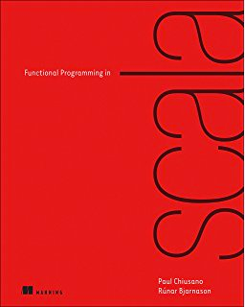
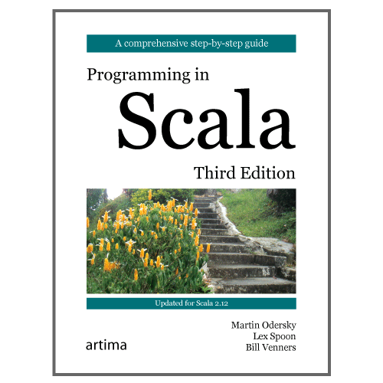
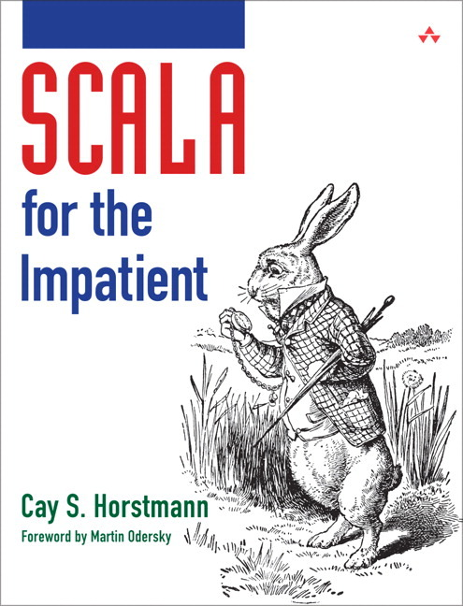
Other Ways to Learn
Books
Scala: Deeply Functional, Purely Object-Oriented
Programming in Scala, 3rd Edition
Scala for the Impatient
Several free courses on Coursera
Twitter’s Scala School

Slide 32
object Salutations { def getSalutationFor(timing: String): String = timing match { case "start" => "Welcome to 100 Days of Scala!" case "middle" => "Are you still awake?" case "end" => "Go fourth and use Scala!" case _ => "Uh oh..." } def main(args: Array[String]): Unit = { println(getSalutationFor("end")) } }

